Slide 1


ISLAB SEMINAR
- Phan Van Hoang Anh -

Slide 2

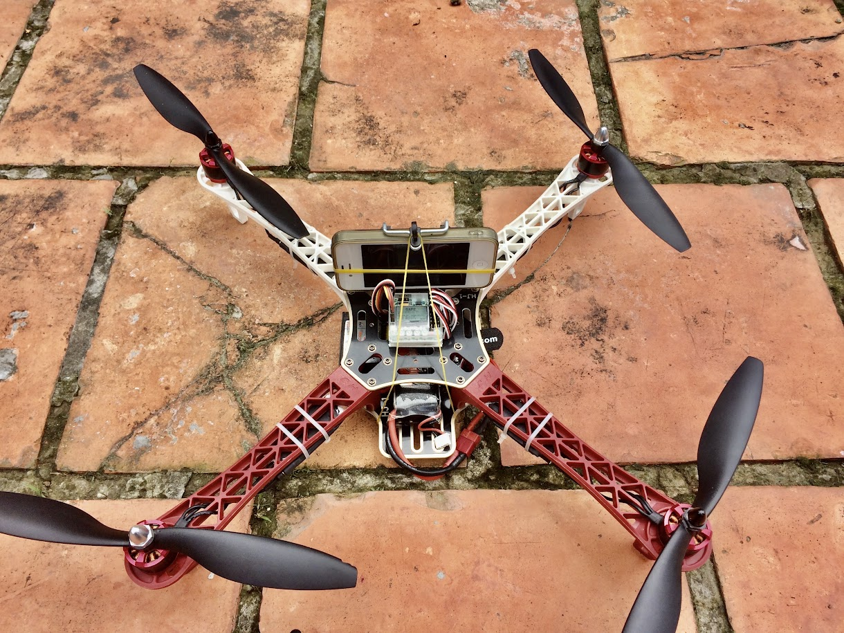
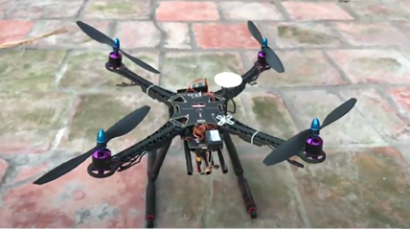
TEAM DRONE
Personal preference
The desire to learn and cultivate

Slide 3
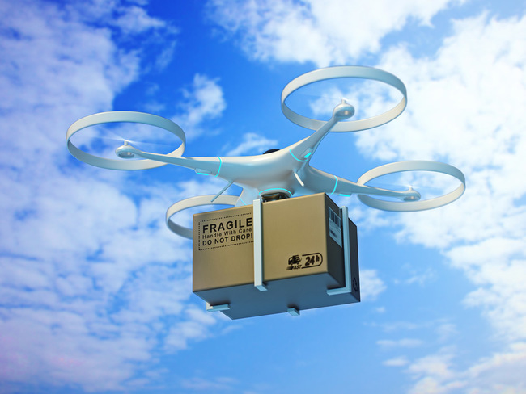
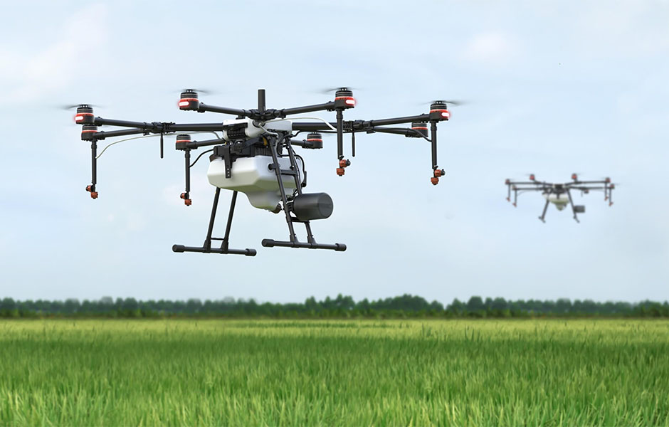
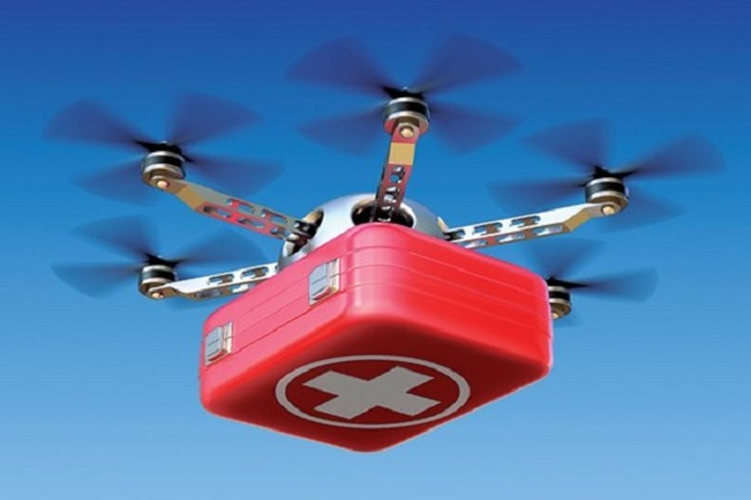
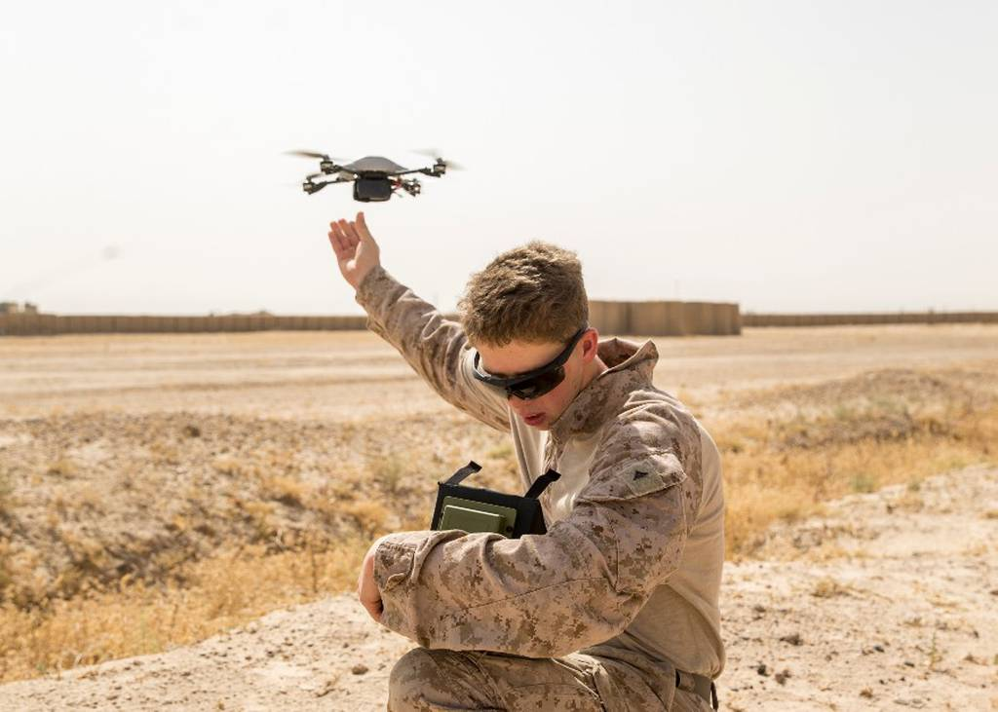
Drone Applications
Shipping
Agricultural
Rescue
Military
…

Slide 4
Semester Plan
Learning
Application

Slide 5

Learning
Python
Image Processing
Linear Algebra

Slide 6
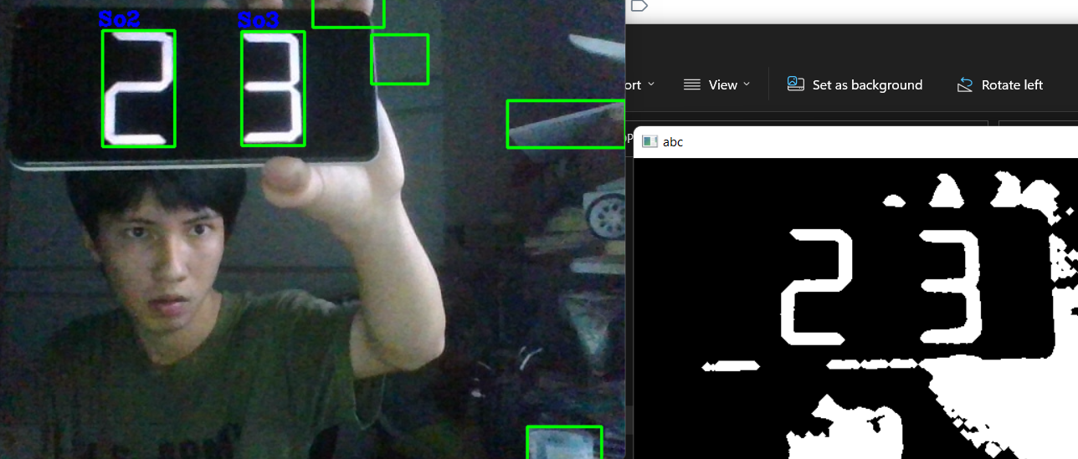
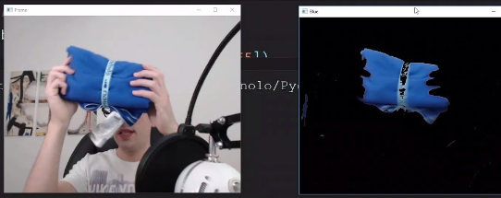
Image Processing
Learning

Slide 7
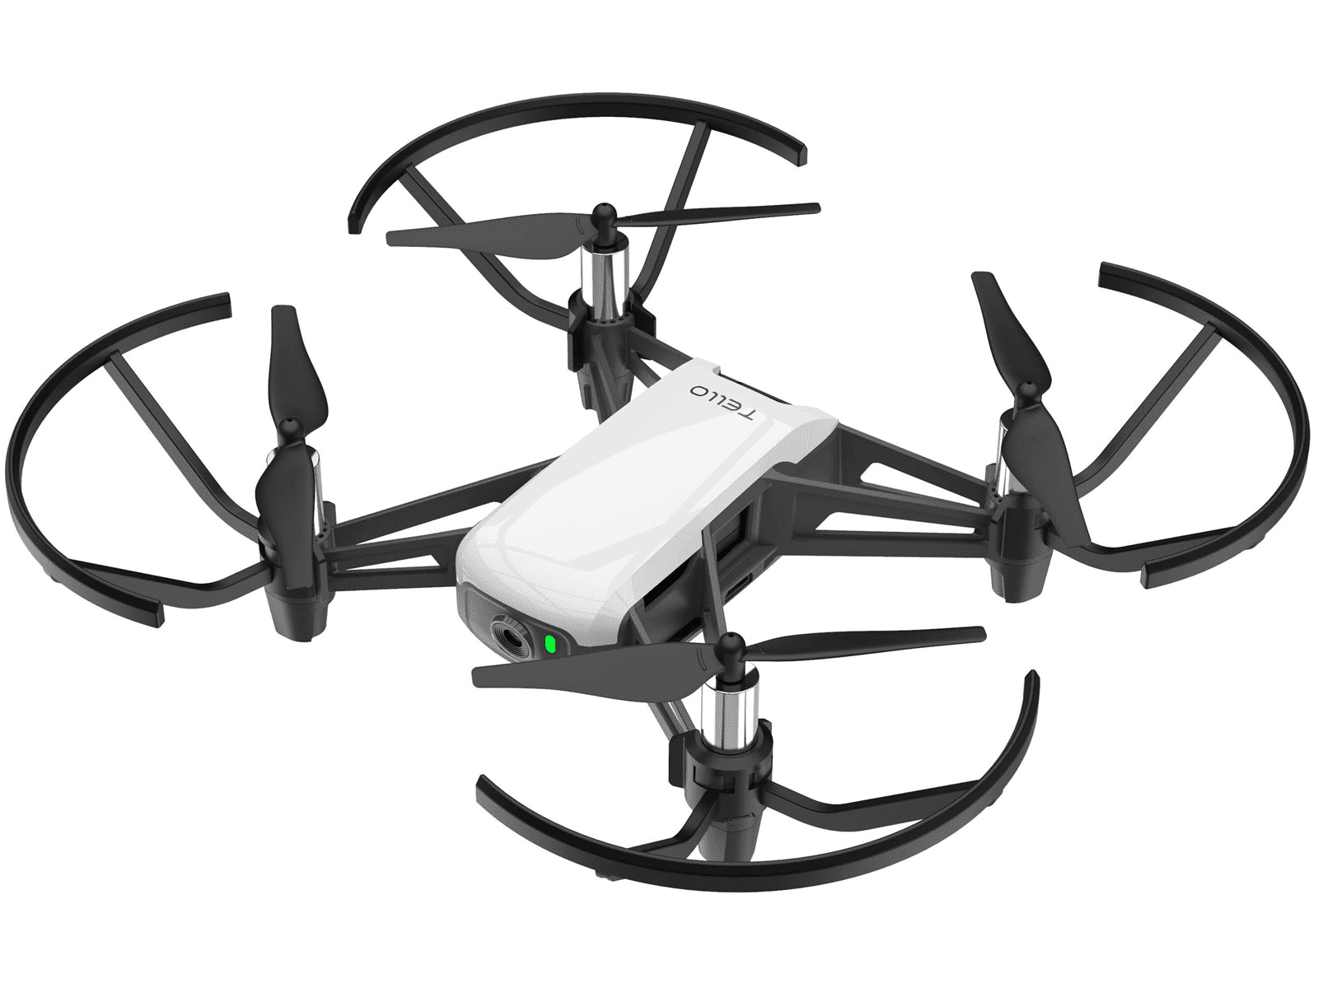
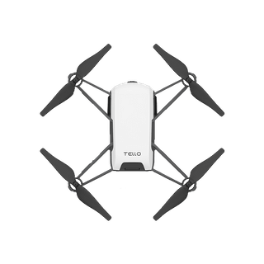
Application
Object dectection and tracking
Mapping
Return home and landing

Slide 8
THANKS FOR LISTENING!!
- Phan Van Hoang Anh -

